Slide 1
Livable Communities & Planning
Maine Association of REALTORS® | Lunch & Learn
By Rodney Harrell, PhD | Vice President, Family, Home and Community | @DrUrbanPolicy
Notes:
NAHB Workshop Description:
America is aging – more than 55 million people are over age 65, and the vast majority want to stay and thrive in their homes and communities as they age. Soon, older adults will outnumber younger adults for the first time in our nation’s history, and our past assumptions about housing must evolve as the population changes. How can we take advantage of this opportunity and close the gap between what we have and what we will need now and in the future? Please join Dr. Rodney Harrell of AARP for an important conversation about the future of housing, including the big demographic changes that are happening now, housing considerations for older adults, and new ways to approach the housing needs of people of all ages.
Notes from past presentations:
Stories/anecdotes upfront
The future is unpredictable
Cleveland—subsidized housing
Alabama—
Retired govt worker/family friend

Slide 2
Major demographic shifts
AARP | AARP.ORG © 2024 AARP ALL RIGHTS RESERVED

Slide 3
By 2034
Americans 65-plus will outnumber those 18 and under for the first time
AARP | AARP.ORG © 2024 AARP ALL RIGHTS RESERVED
Source: US Census National Population Projections 2017
Notes:
US Households
More people are living alone
The middle class is shrinking

Slide 4
Nearly 80% of those 50-plus want to stay in their communities and homes as they age
AARP | AARP.ORG © 2024 AARP ALL RIGHTS RESERVED
Source: AARP 2021 Home and Community Preferences Survey
Notes:
People also want:
Conveniently located grocery stores with healthy food,
Convenient high-quality health care services,
Having housing that is located near key services,
Affordable housing options,
Opportunities for residents to participate on community decision-making bodies and discuss important issues that impact their community
Source: AARP 2021 Home and Community Preferences Survey

Slide 5
In 2021, almost
Less than 1%
of U.S. homes have five accessibility features to support aging in one’s home
11.2 million
households 65-plus were housing cost burdened
AARP | AARP.ORG © 2024 AARP ALL RIGHTS RESERVED
Sources: Harvard University Joint Center for Housing Studies 2019-2023 Housing America’s Older Adults
Notes:
There is a tremendous gap between the number of people who wish to age in place and the number of homes that can support it.
Unfortunately, many of America’s communities do not adequately support residents across the age spectrum in realizing their fullest potential

Slide 6
64 million Americans
live in multigenerational households
Source: Pew Research Center, March 2021
AARP | AARP.ORG © 2024 AARP ALL RIGHTS RESERVED
Notes:
The US population is getting more racially and ethnically diverse
Preference
Cultural customs:
Asian and Hispanic households more likely to live in multigenerational households (29% of Asian households and 27% of Hispanic Households)
Aging in place strategy:
69% of adults would consider sharing their home with a family member or members, not including a spouse, as they get older
54% said they would consider sharing their home with a friend as they get older
Source
Cultural customs:
Numbers come from Pew Research Center analysis of 2016 ACS data
Numbers come from 2021 AARP Home and Community Preferences survey,

Slide 7
The future is unpredictable.
AARP | AARP.ORG © 2024 AARP ALL RIGHTS RESERVED
Notes:
Community Challenges
Communities aren’t prepared
Limited access to community amenities and services
Growing housing cost burden
Lack of housing options
Limited mobility with age
Less than 1% of U.S. homes have the features that support aging
Prevalence of health disparities

Slide 8
How do people choose where to live?
PREFERENCES
Value/price
Neighborhood Amenities
Visual Appeal
Safety Closeness to Family
Religious Institutions
Sense of Community
Political Integration
LIMITATIONS
Lack of Information
Income Limitations
Fear
Discrimination
Local Economic Conditions
Lack of Transportation Choices
Limited Choice of Neighborhoods
HOME AND COMMUNITY LOCATION
AARP | AARP.ORG © 2024 AARP ALL RIGHTS RESERVED
August 21, 2024
8

Slide 9
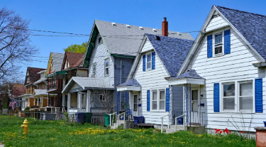
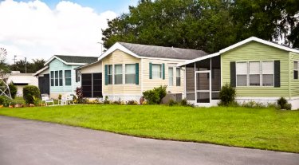
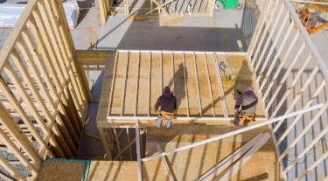
AARP Future of Housing
Seven megatrends that are shaping the future of housing
Advances in Technology
Affordability Gaps
Changing Demographics
aarp.org/futureofhousing
Local Government Influence
Shifts in Environmental Conditions
Supply Mismatch
Systemic Barriers
AARP | AARP.ORG © 2024 AARP ALL RIGHTS RESERVED
August 21, 2024
9

Slide 10
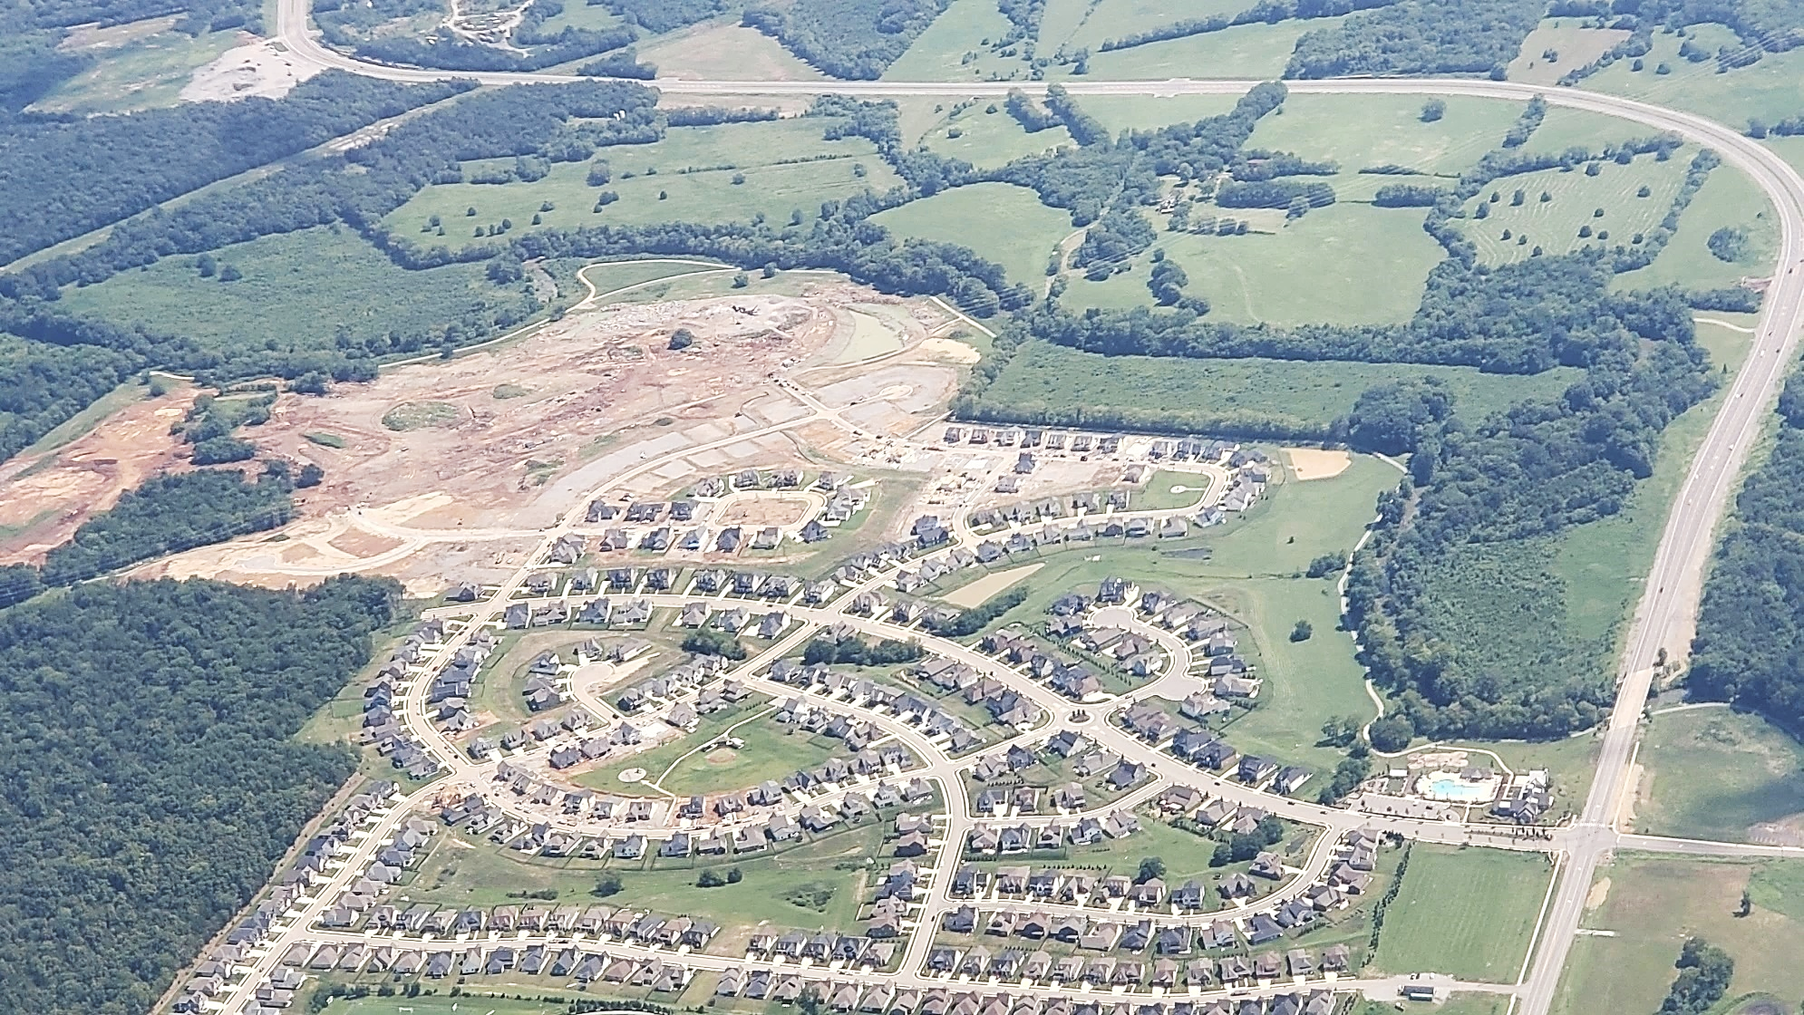
Are we building communities with livability in mind?
AARP | AARP.ORG © 2024 AARP ALL RIGHTS RESERVED
Notes:
Isolation
Needs change over time – is example of woman whose home no longer fits: dream home can become a nightmare

Slide 11
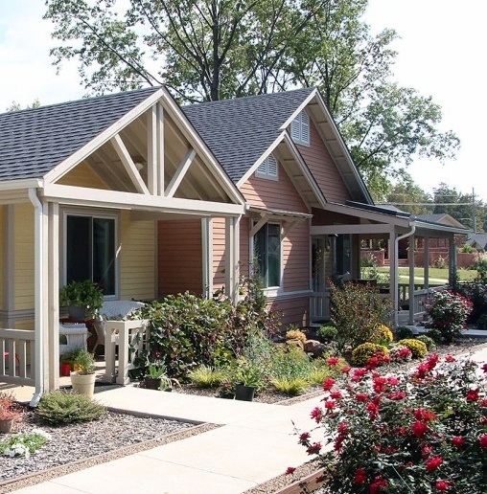
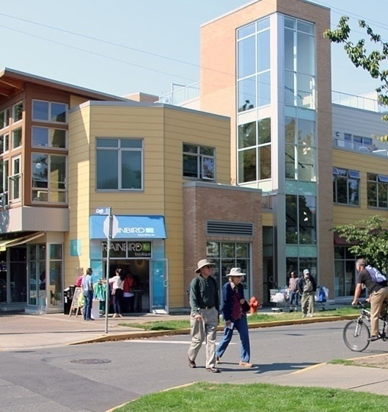
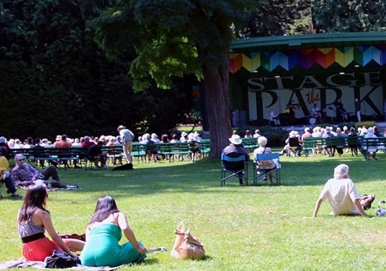
Livable, age-friendly communities provide options that enable you to meet your needs regardless of your age, income, background, or other factors.
They are for all people of all ages.
AARP | AARP.ORG © 2024 AARP ALL RIGHTS RESERVED
Photos: Dan Burden, Shannon Guzman, and Getty Images
Notes:
A livable, age-friendly community is a safe and secure community that:
enhances personal independence through access to supportive community features and services (such as adequate healthcare, reliable public transportation, proximity to grocery stores and parks, and more);
allows residents to remain in their homes and communities as they age (by having affordable and appropriate housing options); and
provides opportunities for residents of all ages, ability levels, and backgrounds to engage fully in civic, economic, and social life.
Once these livable community features are in place, they allow residents of all ages and backgrounds to thrive.

Slide 12
Where the potential lies:
59%
42%
People 50-plus in the US generate $8.3 trillion in economic activity annually.
That will grow to $28.2 trillion by 2050.
$28.2 T
2050
of millennials
of boomers
want neighborhoods with a mix of homes.
$8.3 T
2023
Homes closer to parks and open spaces have higher property values than those further away.
15%
+145%
Compact communities can increase property values by more than
for office, residential, and retail use.
+64%
+33%
Philadelphia, PA
Elizabeth, NJ
Oakland, CA
Sources: ; Longevity Economy® Outlook | AARP 2023 Tech Trends and Adults 50+; The Livability Economy AARP 2015
AARP | AARP.ORG © 2024 AARP ALL RIGHTS RESERVED

Slide 13
What We Do
AARP | AARP.ORG © 2024 AARP ALL RIGHTS RESERVED

Slide 14
Elements of Change
Policy
Industry
People
AARP | AARP.ORG © 2024 AARP ALL RIGHTS RESERVED
August 21, 2024
14
Notes:
All three parts are needed for America to address our housing and livability challenges

Slide 15
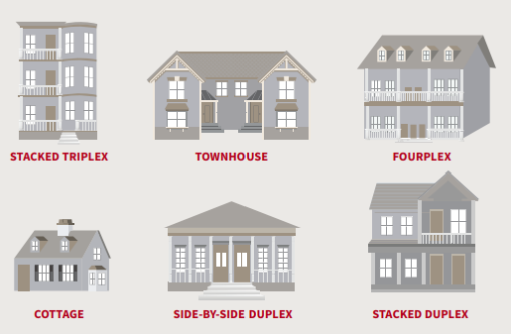
Increasing Housing Options
More housing types
AARP | AARP.ORG © 2024 AARP ALL RIGHTS RESERVED
August 21, 2024
15

Slide 16
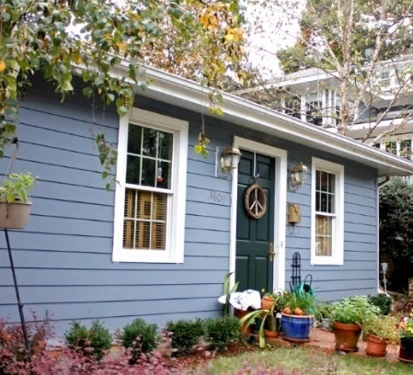
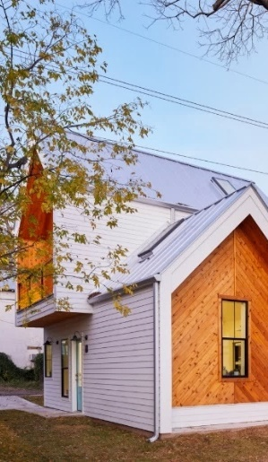
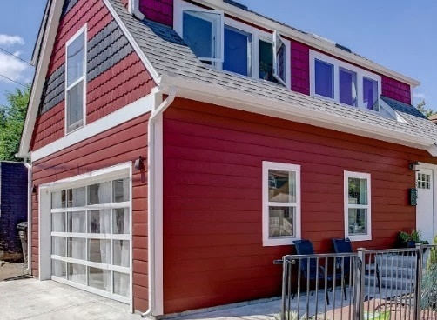
Accessory Dwelling Units (ADUs)
A separate living space (attached or detached) on a lot with an existing home that can accommodate a variety of housing needs.
AARP | AARP.ORG © 2024 AARP ALL RIGHTS RESERVED
Images: Leonid Furmansky, AIA-DC,ADU Home Tour
Notes:
62% of adults would consider building an ADU on their property to provide a place for a loved one needing care
Benefits of ADUs
Aging in home and community
Accessibility for people with limited mobility
Space for caregiver
Entry-level housing
Income generation
More attainable housing options in the community

Slide 17
Reasons for Building An ADU
Adults, age 50+
83%
83%
80%
74%
73%
65%
58%
Provide a home for a loved one in need of care
Provide housing for relatives or friends
Create a place for a caregiver to stay
Have a space for guests
Feel safer by having someone living nearby
Increase the value of their home
Earn extra income from renting to a tenant
Source: AARP 2021 Home and Community Preference Survey
AARP | AARP.ORG © 2024 AARP ALL RIGHTS RESERVED
August 21, 2024
17

Slide 18
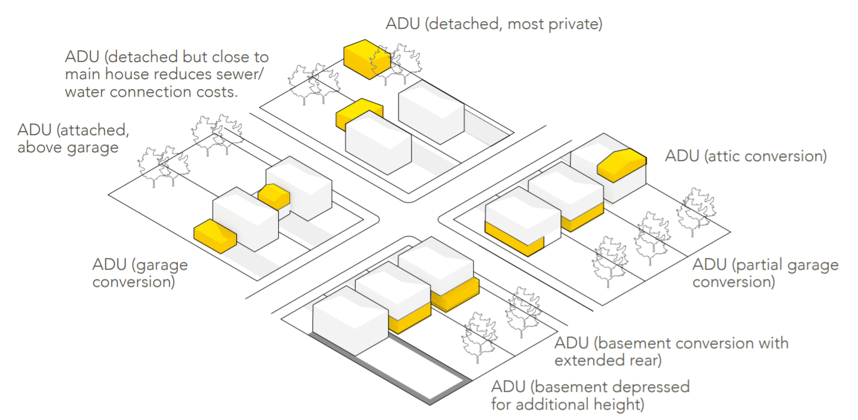
ADU Building Types
ADUs come in many shapes and styles
Source: AARP Accessory Dwelling Units: A Step By Step Guide to Design and Development, 2019
AARP | AARP.ORG © 2024 AARP ALL RIGHTS RESERVED
August 21, 2024
18

Slide 19
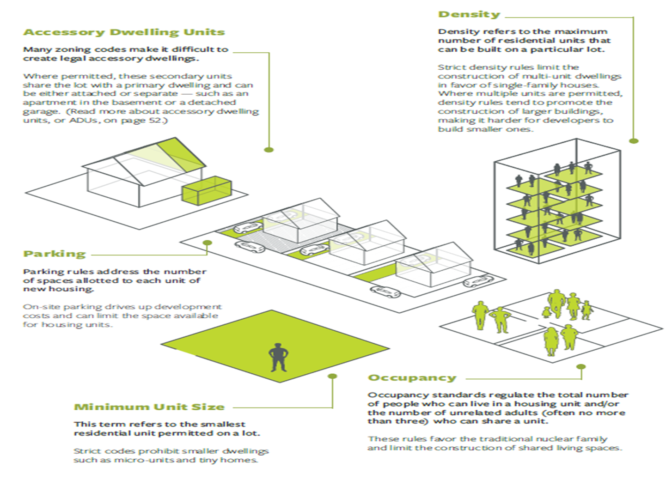
Benefits and Challenges
Barriers to ADU development
Political
Regulatory
Procedural
Financial
AARP | AARP.ORG © 2024 AARP ALL RIGHTS RESERVED
Source: Making Room: Housing for a Changing America, 2019
19

Slide 20
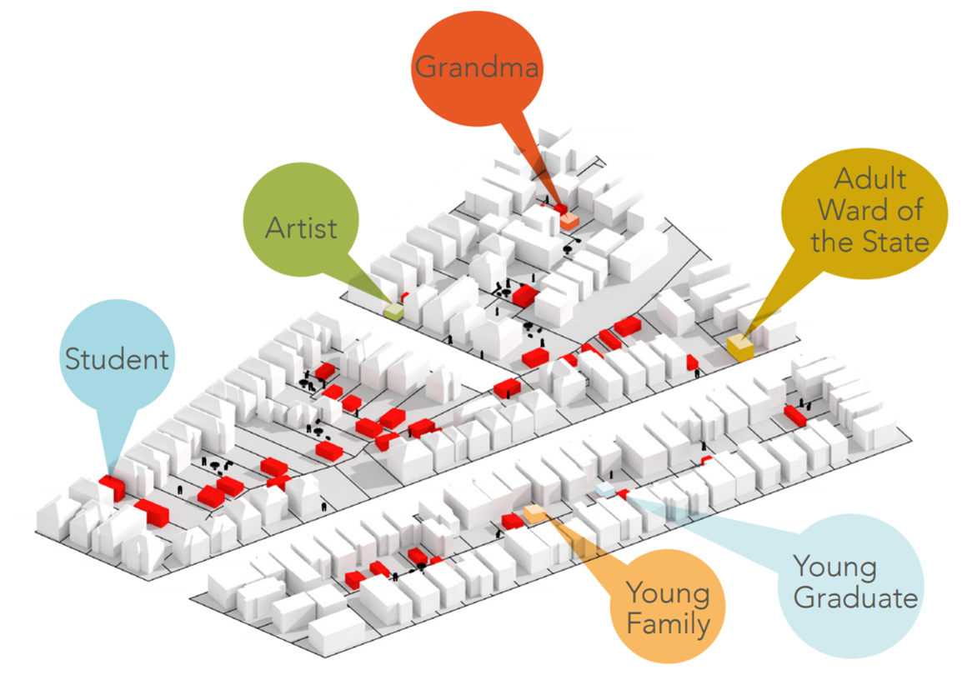
Benefits and Challenges
ADU Benefits:
Aging in home and community
Accessibility for people with limited mobility
Space for caregiver
Entry-level housing
Income generation
More affordable housing options in the community
AARP | AARP.ORG © 2024 AARP ALL RIGHTS RESERVED
Source: AARP Accessory Dwelling Units: A Step By Step Guide to Design and Development, 2019
20

Slide 21
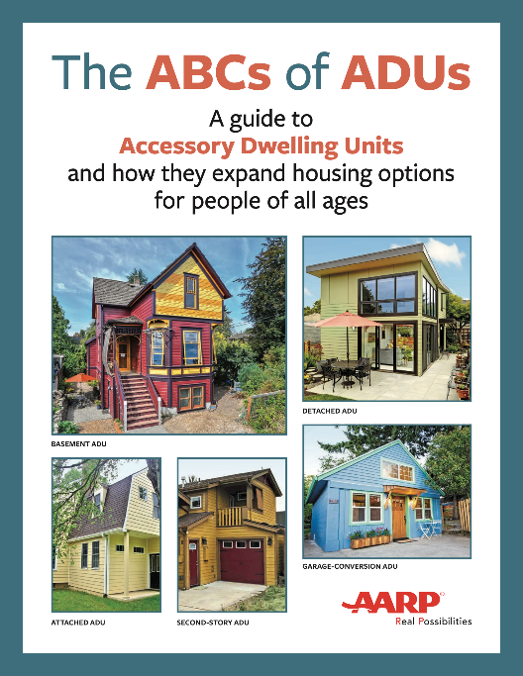
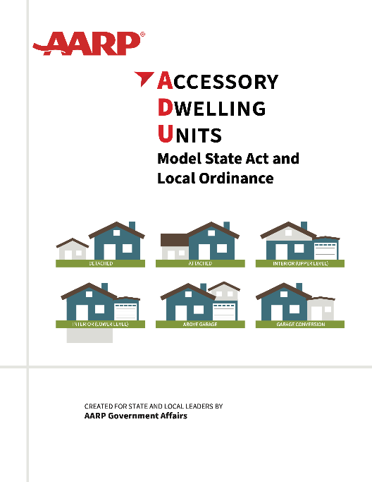
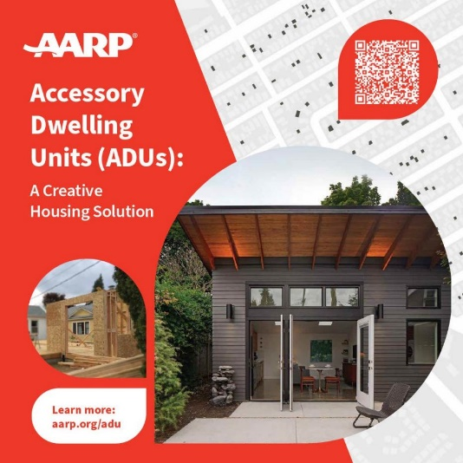
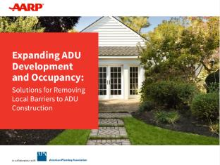
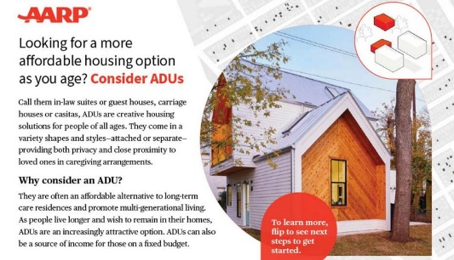
AARP ADU Resources
Visit aarp.org/adu
Design guide
Intro overview
Model legislation
Brochures
Policy solutions
Visit the website to download digital versions of these resources or to order a print version.
AARP | AARP.ORG © 2024 AARP ALL RIGHTS RESERVED
August 21, 2024
21

Slide 22
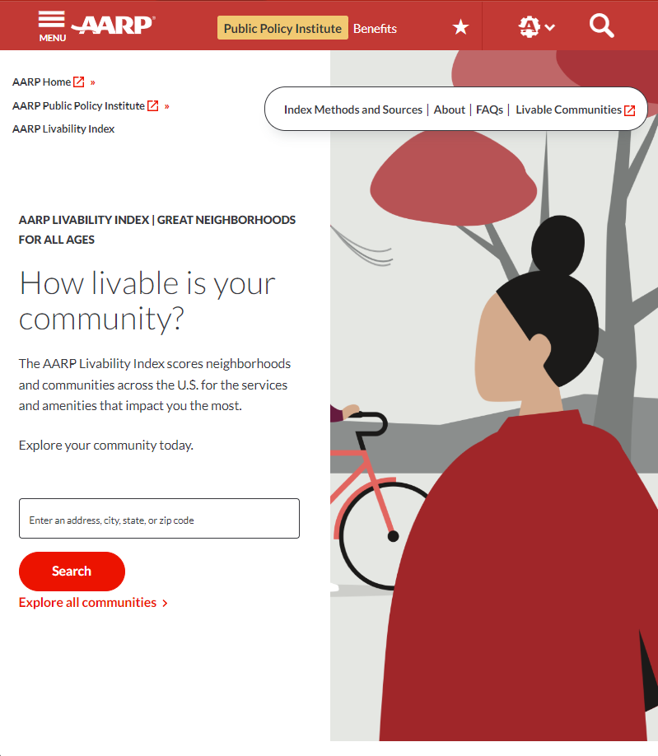
AARP Livability IndexTM Platform
Using more than 50 national sources of data, the platform measures how well a community meets the current and future needs of people of all ages, regardless of income, physical ability, or ethnicity.
aarp.org/livabilityindex
AARP | AARP.ORG © 2024 AARP ALL RIGHTS RESERVED

Slide 23
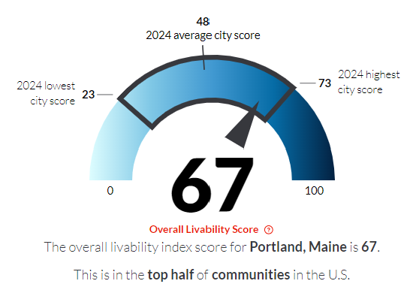
Livability Categories & Scores
Housing
Neighborhood
Transportation
Environment
Health
Engagement
Opportunity
AARP | AARP.ORG © 2024 AARP ALL RIGHTS RESERVED
August 21, 2024
23
Notes:
Overall Livability Score
Captures the complexity of what produces a high quality of life for a diverse population across many ages in seven categories of livability
Every location in the US is scored on a scale from 0 to 100
The average location scores a 50
Neighborhood scores range from 20 to 76
City scores range from 23 to 73
ATTRIBUTES
Housing
Housing accessibility
Housing options
Housing affordability
Neighborhood
Proximity to destinations
Mixed-use neighborhoods
Compact neighborhoods
Personal safety
Neighborhood quality
Transportation
Convenient transportation options
Transportation costs
Safe streets
Accessible system design
Environment
Water quality
Air quality
Resilience
Energy efficiency
Health
Healthy behaviors
Access to health care
Quality of health care
Engagement
Internet access
Civic engagement
Social engagement
Equal rights
Opportunity
Equal opportunity
Economic opportunity
Education
Multi-generational communities
Local fiscal health

Slide 24
Components of Livability
Categories and Attributes
Category
General topic areas that define the type of characteristics found within a community
HOUSING
NEIGHBORHOOD
TRANSPORTATION
ENVIRONMENT
Housing accessibility
Housing options
Housing affordability
Proximity to destinations
Mixed-use neighborhoods
Compact neighborhoods
Personal safety
Neighborhood quality
Convenient transportation options
Transportation costs
Safe streets
Accessible system design
Water quality
Air quality
Resilience
Energy efficiency
Attribute
Qualities or features regarded as a characteristic of a livable community
HEALTH
ENGAGEMENT
OPPORTUNITY
Healthy behaviors
Access to health care
Quality of health care
Internet access
Civic engagement
Social engagement
Equal rights
Equal opportunity
Economic opportunity
Education
Multi-generational communities
Local fiscal health
AARP | AARP.ORG © 2024 AARP ALL RIGHTS RESERVED

Slide 25
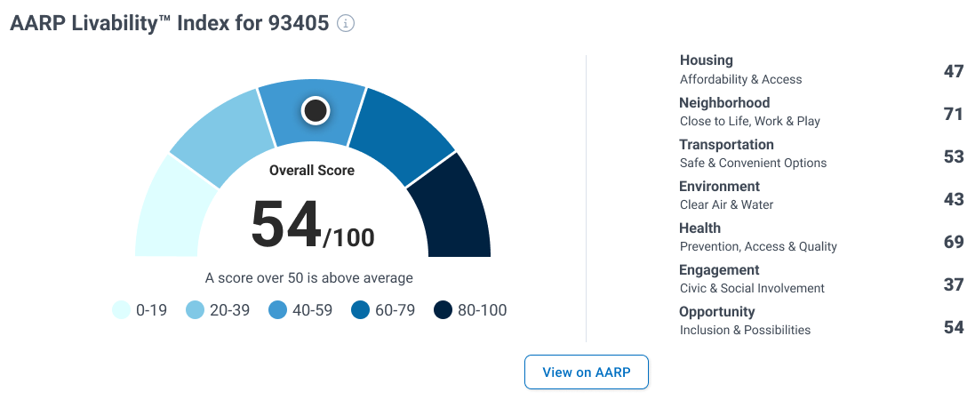
AARP and NAR: Educating Homebuyers on Livable Communities since 2021
We’ve joined forces to increase consumer confidence and ability to make age-friendly decisions in home-related purchases and actions through a marquee relationship that enhances the REALTORS® toolbox
AARP | AARP.ORG © 2024 AARP ALL RIGHTS RESERVED
August 21, 2024
25

Slide 26
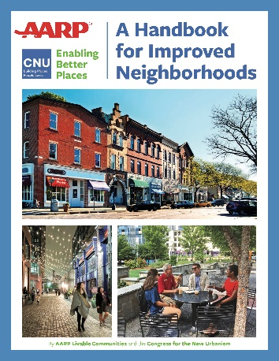
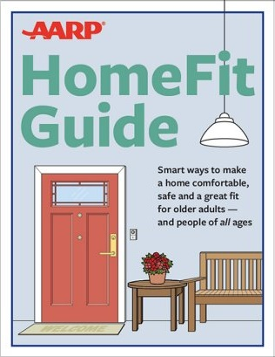
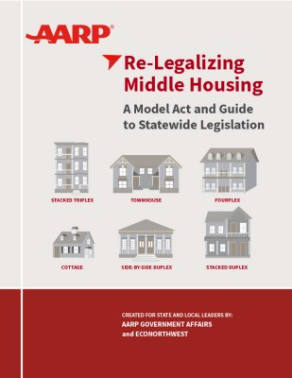
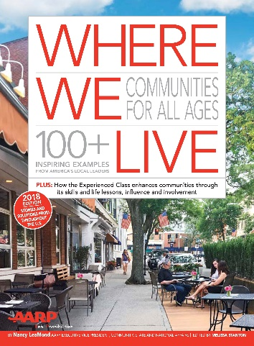
AARP Livable Communities Resources
aarp.org/livable
AARP | AARP.ORG © 2024 AARP ALL RIGHTS RESERVED
August 21, 2024
26
Notes:
Visit aarp.org/livable

Slide 27
JUST RELEASED
Aging Well in America:
AARP’s Vision for a National Plan on Aging
GOAL 1: Promote healthy living and access to affordable, high-quality health care.
GOAL 2: Support family caregivers and ensure access to affordable high-quality LTSS that maximizes the dignity, independence, and protection of older adults.
GOAL 3: Provide ample opportunities to generate, save, and preserve financial sources.
GOAL 4: Create age-friendly, livable communities that enable people to age in place and continued as engagement members of their communities.
aarp.org/agingwell
AARP | AARP.ORG © 2024 AARP ALL RIGHTS RESERVED
August 21, 2024
27

Slide 28
Incremental is radical.
The Big Power of Small Changes
The big power of small changes.
Small Changes, Big Impact
Progress Grows Gradually
AARP | AARP.ORG © 2024 AARP ALL RIGHTS RESERVED
August 21, 2024
28
Notes:
We need to think differently.
Reality of being incremental
Small victories build to big victories – Anna has example of a small victory that built to a bigger one. Transit line.

Slide 29
Questions?
AARP | AARP.ORG © 2024 AARP ALL RIGHTS RESERVED

Slide 30
Connect with us!
If you have a question or have an idea to share, please reach out!
Rodney Harrell, PhD
Vice President, Family, Home and Community
rharrell@aarp.org
@DrUrbanPolicy
Helena Poda
Director, Strategic Relationships
hpoda@aarp.org
AARP | AARP.ORG © 2024 AARP ALL RIGHTS RESERVED

Slide 31
Thank you!

